Slide 1
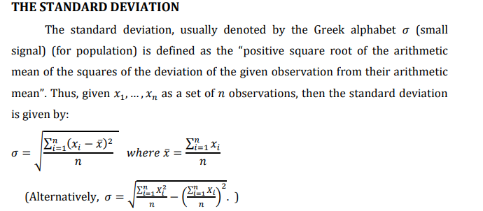

Slide 2
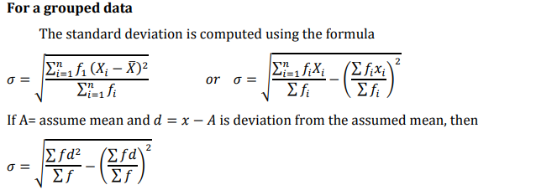

Slide 3
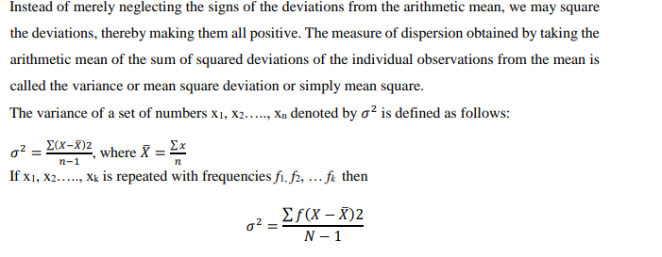

Slide 4
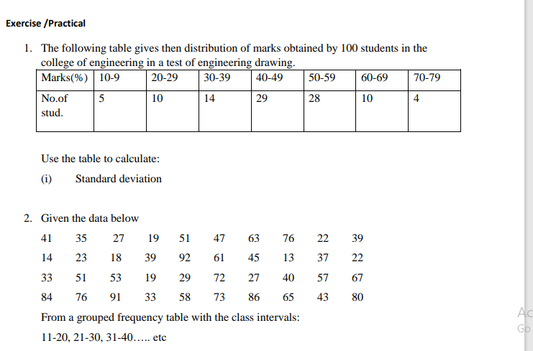

Slide 5
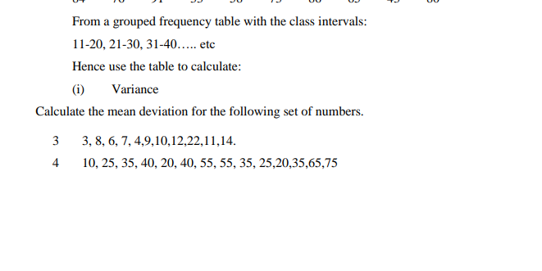

Slide 6

COEFFICIENT OF VARIATION/DISPERSION
This is a dimension less quantity that measures the relative variation between two servers observed in different units. The coefficients of variation are obtained by dividing the standard deviation by the mean and multiply it by 100. Symbolically

Slide 7

EXAMPLE
Given the data below, compute:
Standard Deviation
Variance
Coefficient of Variation

Slide 8
